Slide 1
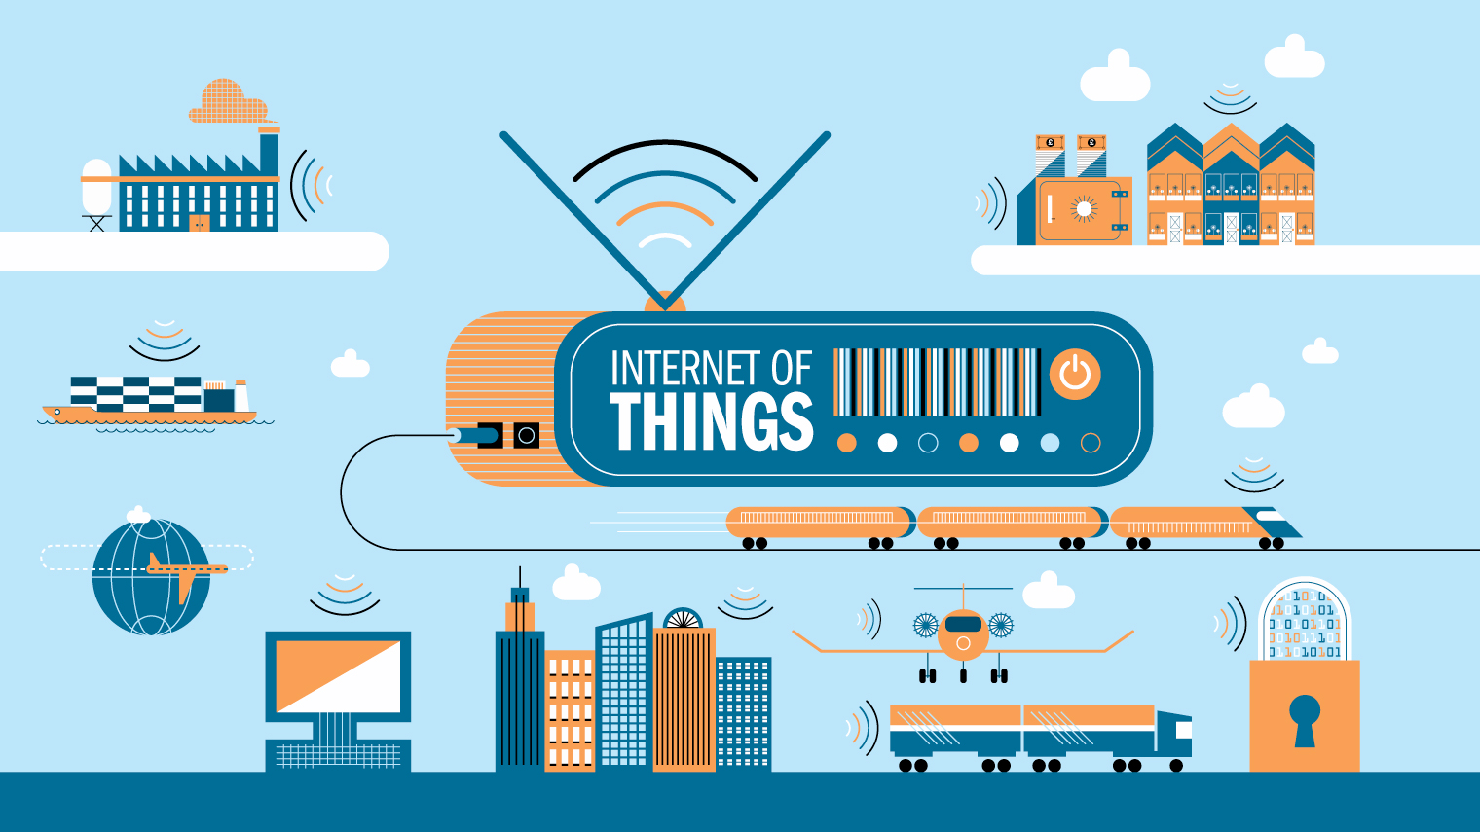

Slide 2
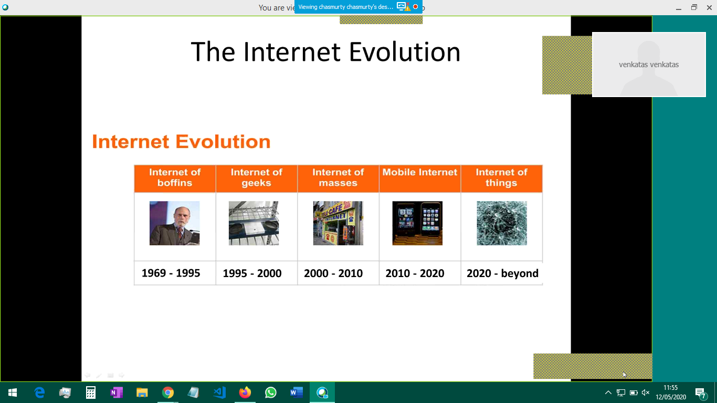

Slide 3
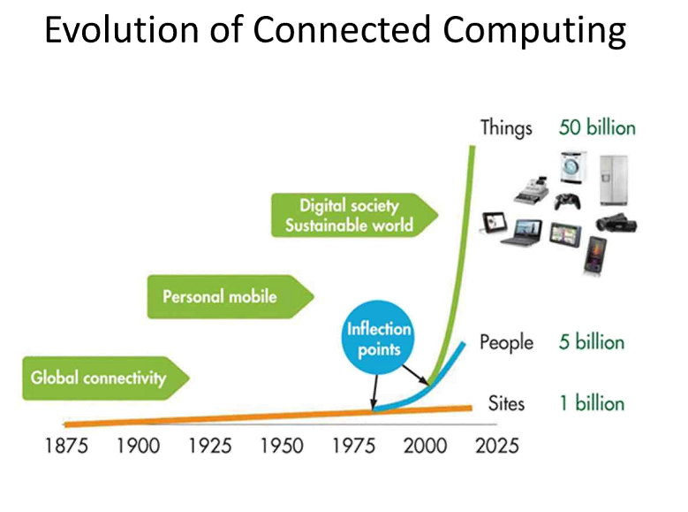

Slide 4
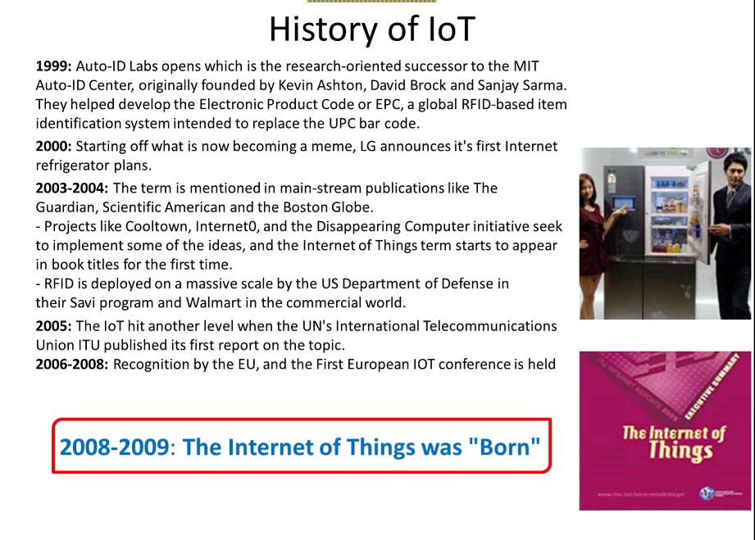

Slide 5
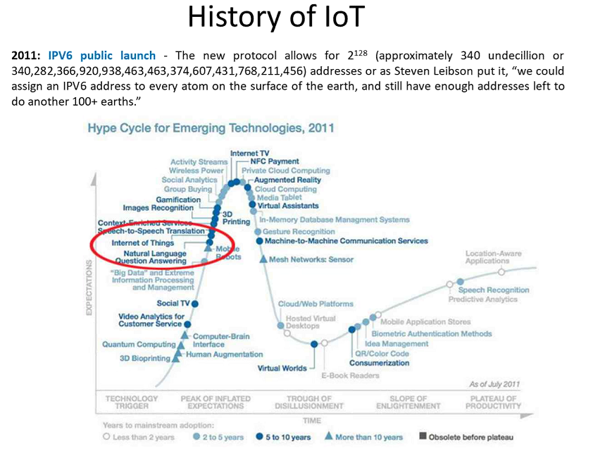

Slide 6
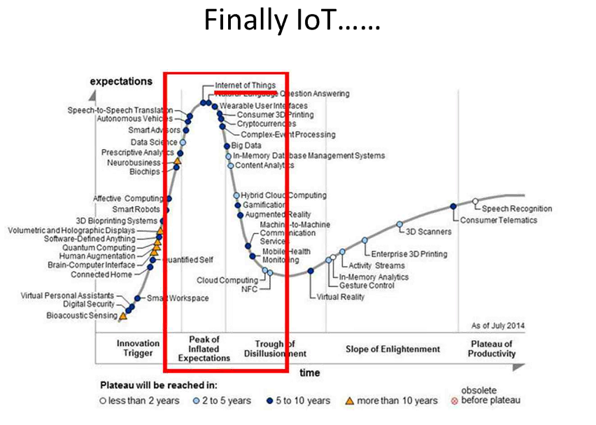

Slide 7
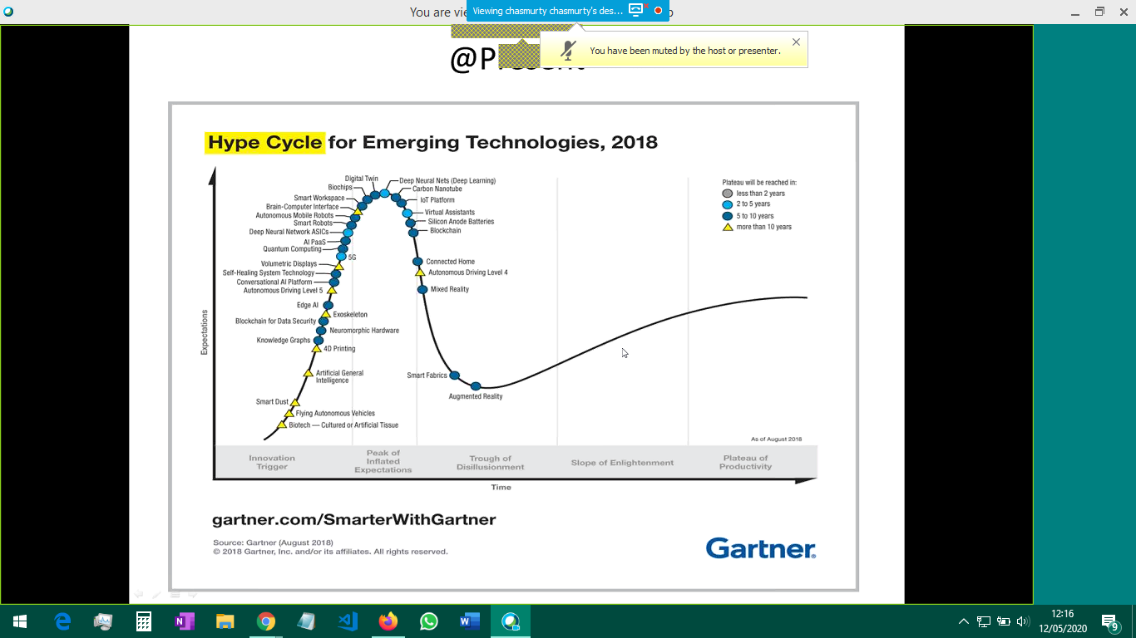

Slide 8
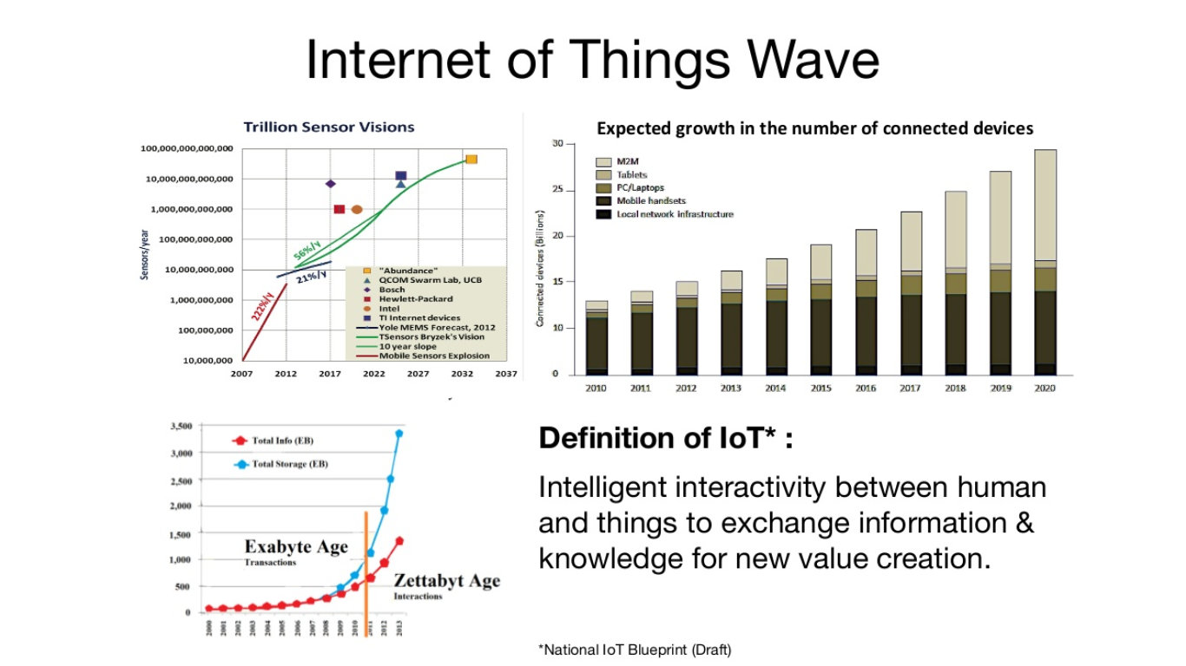

Slide 9
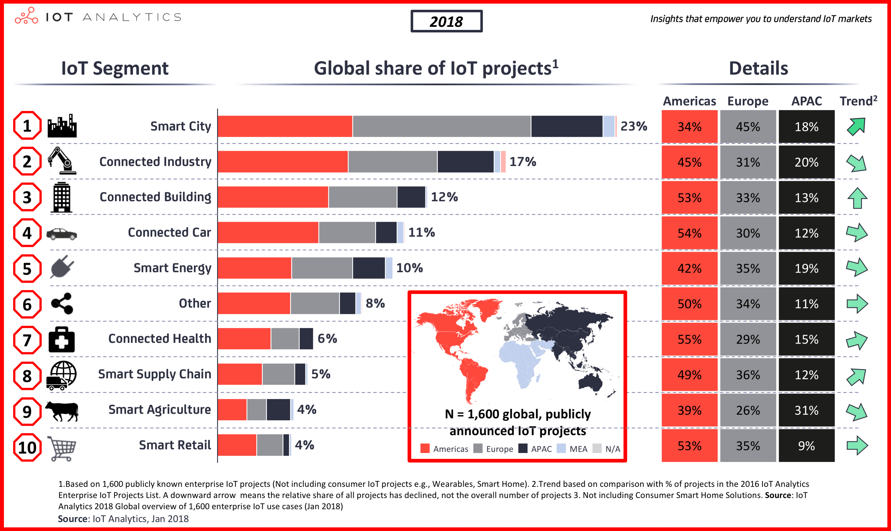

Slide 10
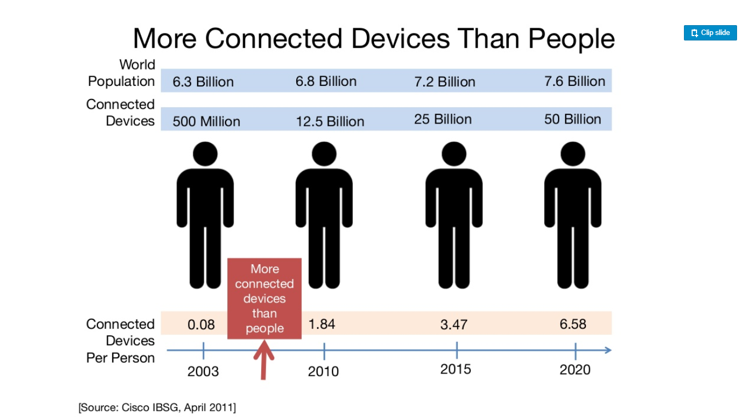

Slide 11
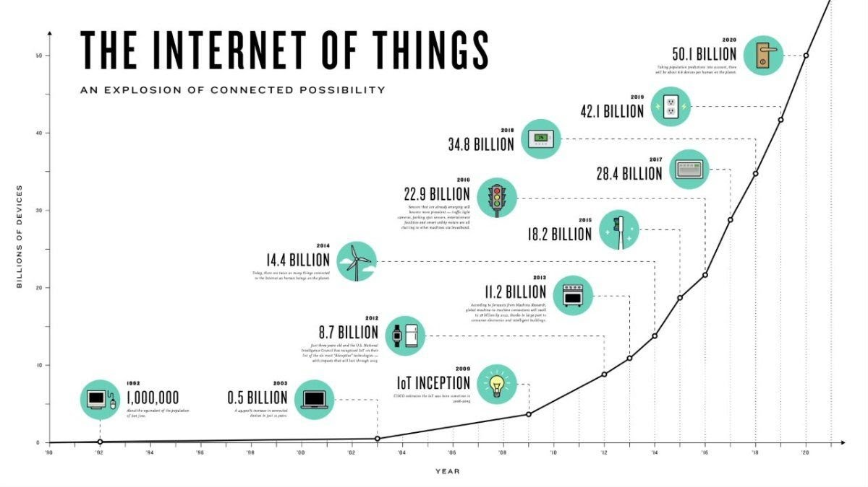

Slide 12
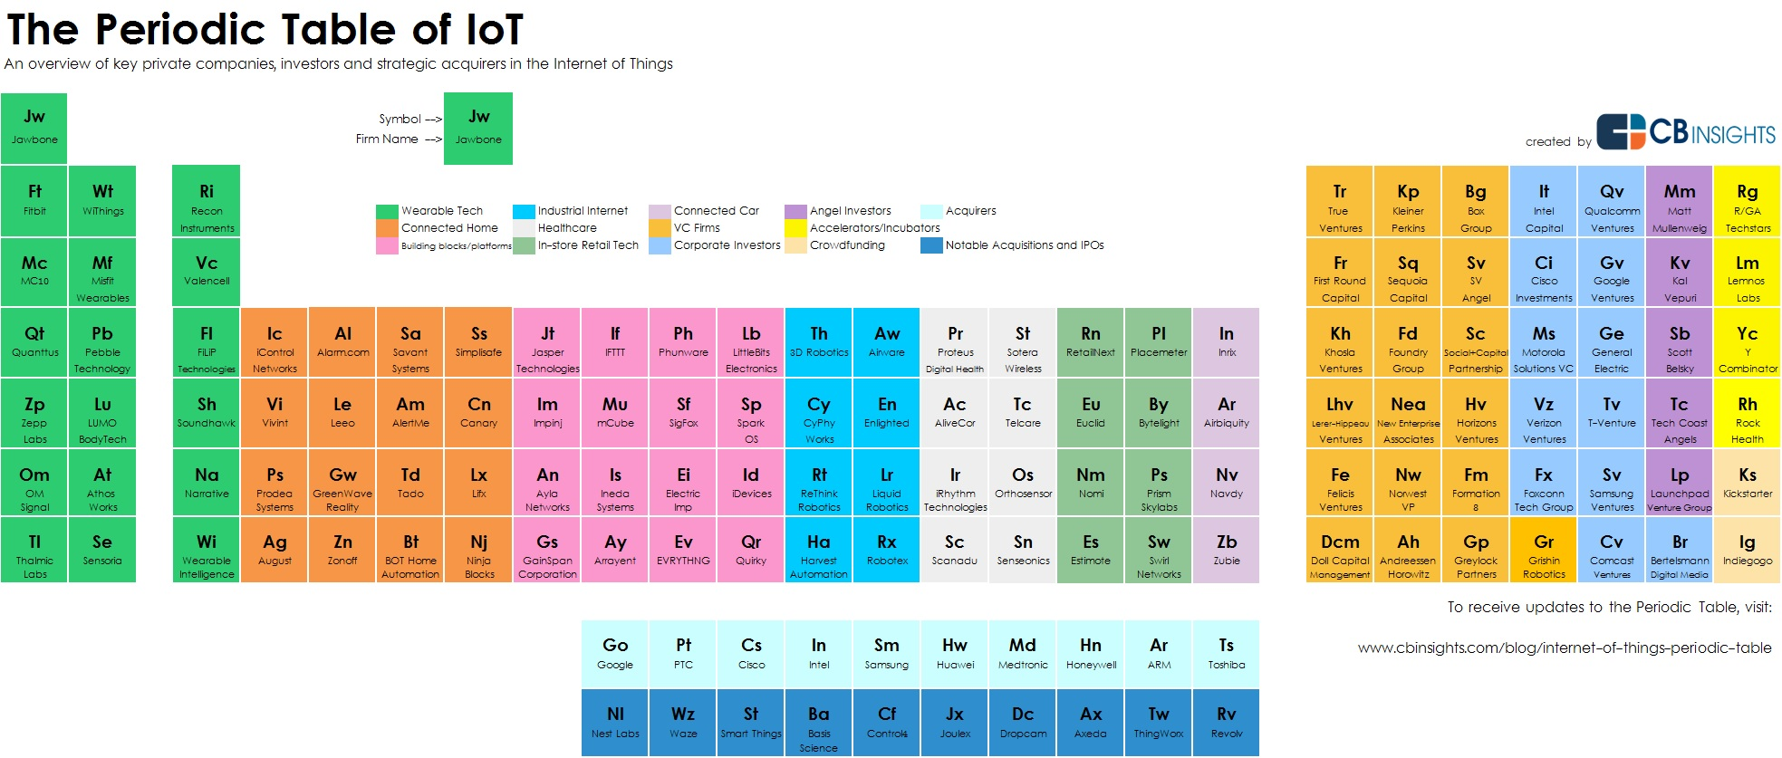

Slide 13
Things
We can turn almost every object into a “thing”.
A “thing” still looks much like an embedded system currently.
A “thing” has the following properties:
A thing is a constraint device.
It is usually powered by battery. This implies limits source of energy.
It’s generally small in size and low in cost. This limits their computing compatibility.
It doesn’t usually perform complicated tasks.
Power consumption is the main design issue

Slide 14
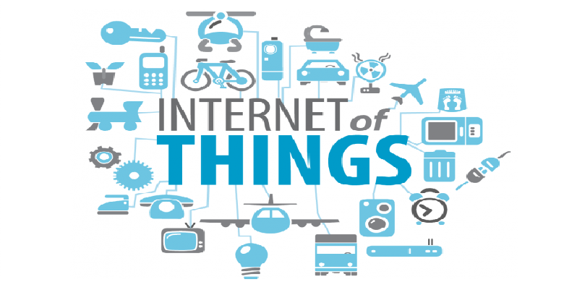
Define: Internet of Things(IoT)
Coined by Kevin Ashton in 1999.
Refers to uniquely identifiable objects and their virtual representations in an internet like structure.

Slide 15
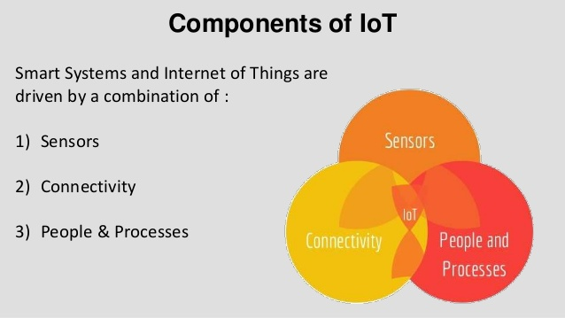

Slide 16
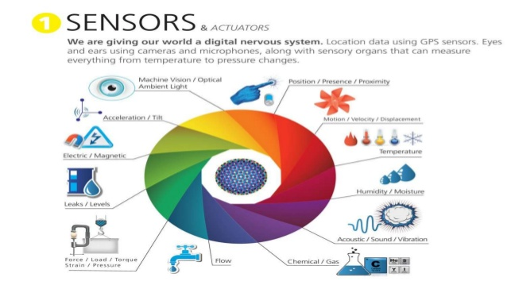

Slide 17
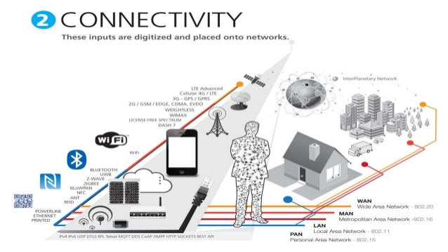

Slide 18
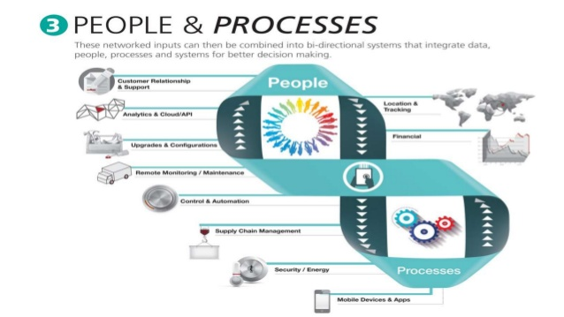

Slide 19
IoT components: Decrypt further
Sensors / Actuators (End device)
Connectivity to Internet
Data,people & processing (Decision making) Data Analytics
Decrypt further...
Sensors
Controller
Comm. interface
Gateway
Cloud
Mobile
VUI
Accelerometer
Temperature
Ultrasonic
Apple S1
Qualcomm-wear 2100
Mediatek MT2502
Bluetooth
Zigbee
Wi-Fi
Gsm/GPRS
Ethernet
Web interface
Dashboard as in Ubidots
Mediatek cs
Apps for Android
IOS
Alexa
Google’s home assistant

Slide 20
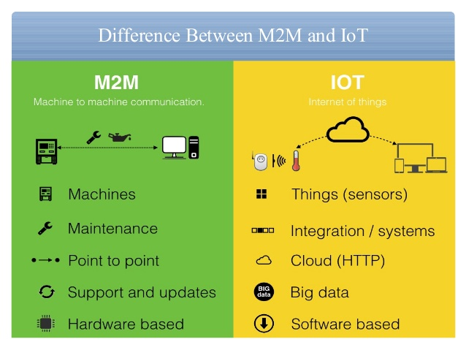

Slide 21
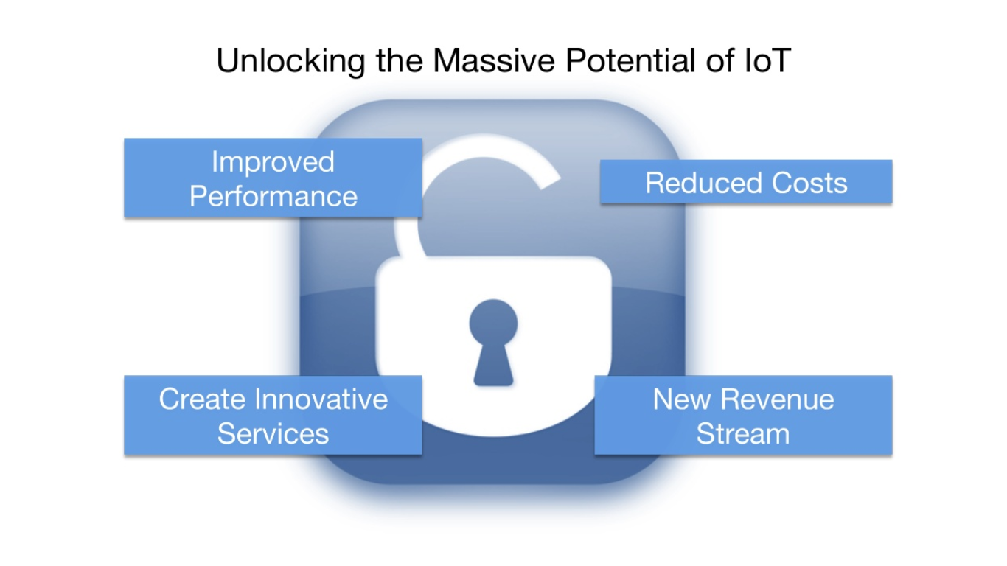

Slide 22
IoT Boards

Slide 23
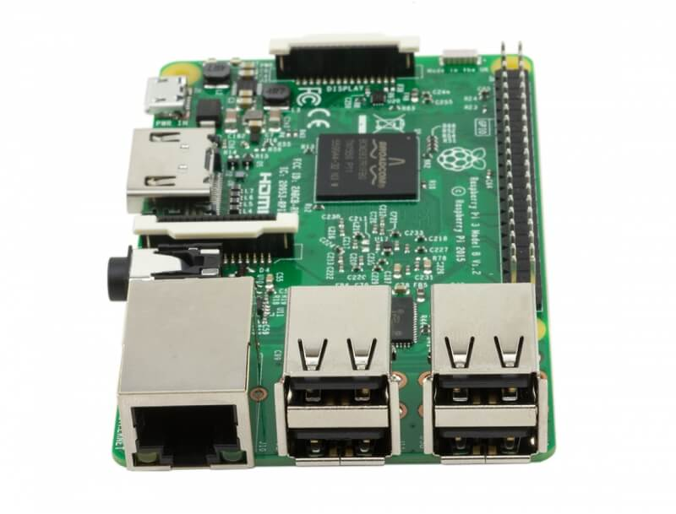
Raspberry Pi
Features of Pi3-
Quad Core 1.2GHz Broadcom BCM2837 64bit CPU.
1GB RAM.
BCM43438 wireless LAN and Bluetooth Low Energy (BLE) on board.
100 Base Ethernet.
40-pin extended GPIO.
4 USB 2 ports.
4 Pole stereo output and composite video port.
Full size HDMI.

Slide 24
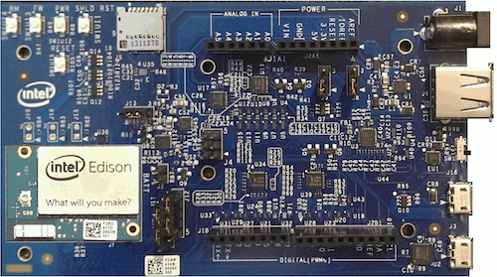
Intel Edison
Intel Edison is a high-performance, dual-core CPU
single core micro-controller that can support complex data collection.
It has an integrated Wi-Fi certified in 68 countries, Bluetooth® 4.0 support
1GB DDR and
4GB flash memory
Arduino breakout board has 20 digital input/output pins, including four pins as PWM outputs
Six analog inputs, one UART (Rx/Tx), and one I2C pin

Slide 25
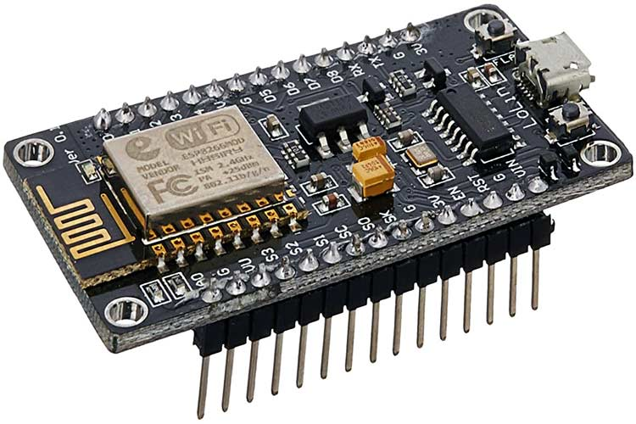
NodeMCU
Microcontroller: Tensilica 32-bit RISC CPU Xtensa LX106
Operating Voltage: 3.3V
Input Voltage: 7-12V
Digital I/O Pins (DIO): 16
Analog Input Pins (ADC): 1
UARTs: 1
SPIs: 1
I2Cs: 1
Flash Memory: 4 MB
SRAM: 64 KB
Clock Speed: 80 MHz
USB-TTL based on CP2102 is included onboard, Enabling Plug n Play
PCB Antenna
Small Sized module to fit smartly inside your IoT projects

Slide 26
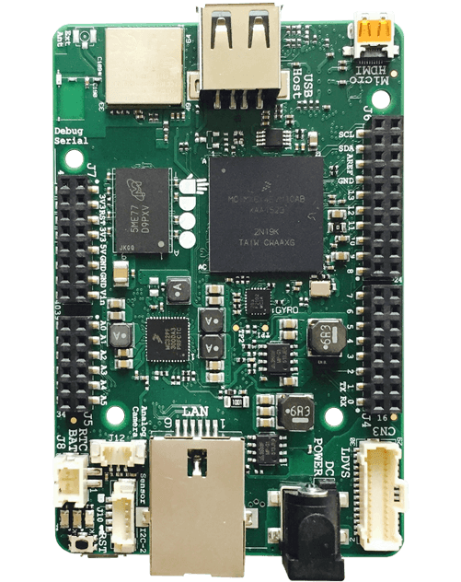
Udoo Neo
NX i.MX 6SoloX applications processor with an embedded ARM Cortex-A9 core.
Integrated 2D/3D graphics controller
Micro HDMI interface – LVDS interface + touch (I2C signals)
Analog camera connection supporting NTSC and PAL – 8-bit parallel camera interface
MicroSD card slot onboard – 8-bit SDIO interface
HDMI audio transmitter – S/PIDF & I2S
1x USB 2.0 Type A ports – 1x USB OTG (micro-AB connector)
Wi-Fi 802.11 b/g/n, Direct Mode SmartConfig and Bluetooth 4.0 Low Energy

Slide 27
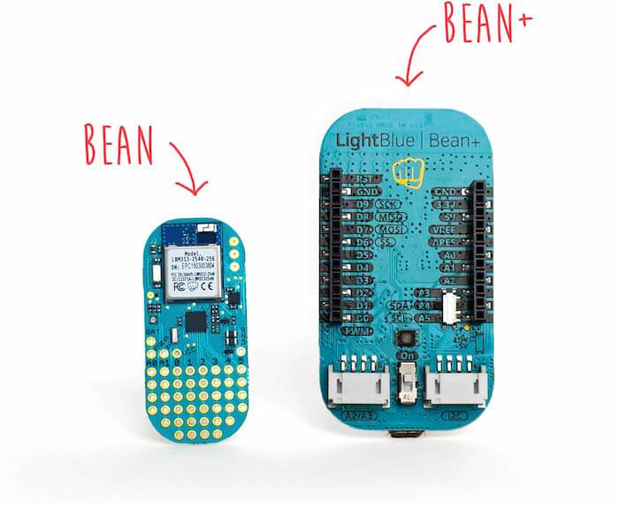
Light Bluebean
3-axis accelerometer
Temperature sensor
RGB LED
CR2032 coin cell battery
ATmega 328p
8 MHz clock speed
3V operating voltage
6 digital I/O pins, 2 analog pins
Bluetooth LE Peripheral
Wireless programming
Support on OS X and iOS

Slide 28
IoT Board Selection

Slide 29
For Prototyping- For mass Production-
Flexibility — Usually breadboardable and has an open SIM card slot
Affordability — Low cost
Modularity — Compatibility with other hardware ecosystems
Ease of use — Can be set up in minutes and comes with tools
Beginner audiences — Content and examples optimized for beginners
Reliability — Has SMT(surface-mount-technology) components, can withstand extreme temperatures, and comes with hardware warranties
Manufacturability — Pick and place machine-ready
High volumes — Can be purchased in bulk via a reliable distribution partner
Ease of integration — Should have complete product certifications
Advanced audiences — Comprehensive datasheets and application notes

Slide 30
Other Factors to Consider When Choosing IoT Boards
1. A Consistent Platform, Infrastructure, Firmware, and Development Tools-You’ll want to continue using the same cloud infrastructure and development tools as you scale. Switching between different hardware designs is enough of a task — you don’t want to carry this over to the software you are using.
2. Domain Experts and Support-When selecting a hardware-solution, it’s also important to consider the community surrounding it. Hardware solutions with limited adoption will have fewer resources available to aid you in development
3. Ease of Deployment-You want to be able to get your product up and running as quickly as possible. When sourcing hardware, check the articles and documentation that comes with it. Having these resources at the ready will make it easy for you to get your questions answered immediately.
4. The Bottom Line-When sourcing prototyping and production hardware, you want to examine its accessibility, affordability, integrations, and manufacturing features. Whether you’re prototyping or building a scalable IoT product, you want to choose hardware that offers a consistent platform environment and ease-of-deployment.

Slide 31
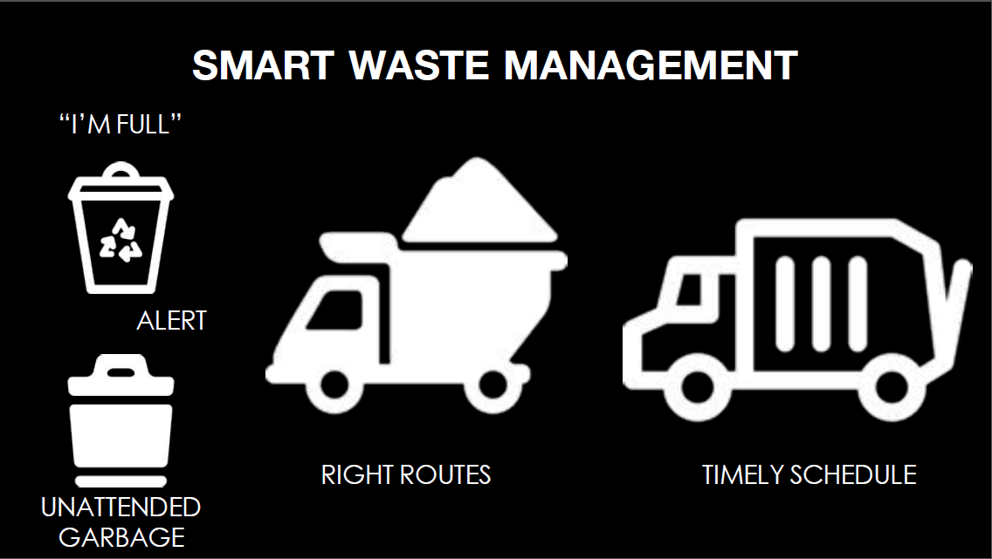

Slide 32
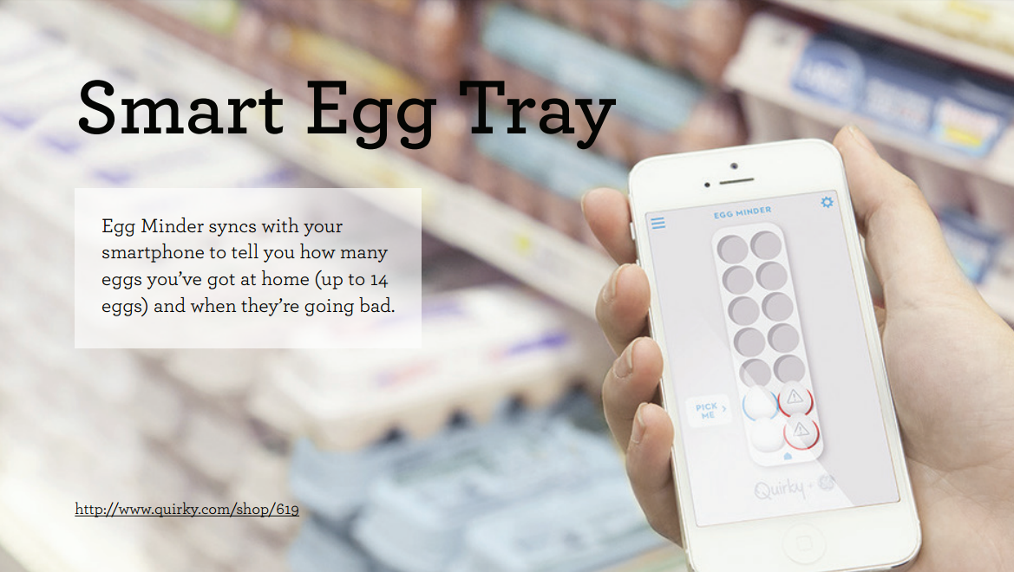

Slide 33
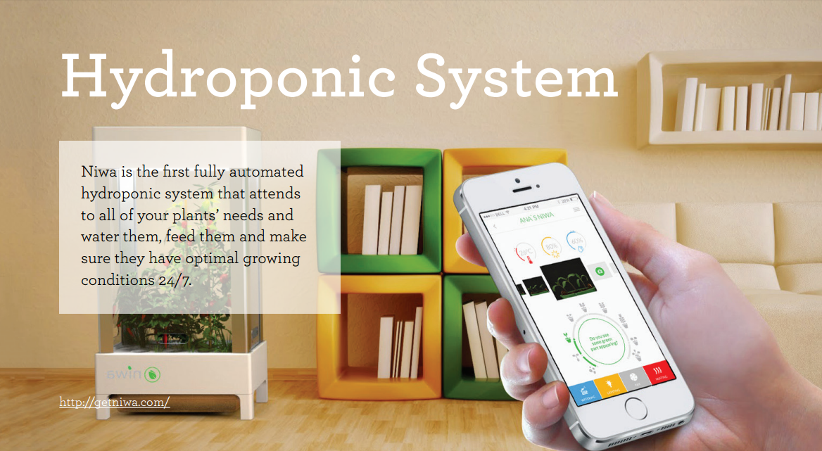

Slide 34
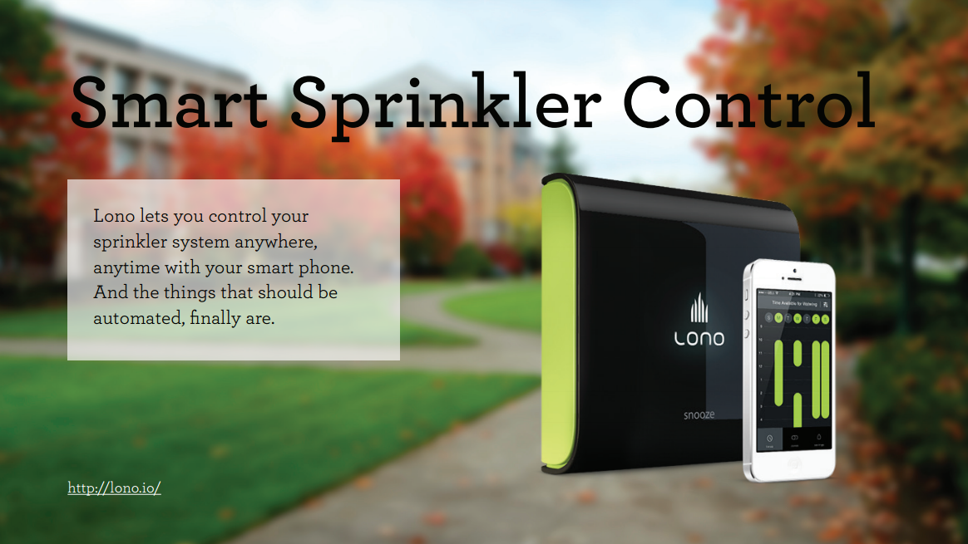

Slide 35
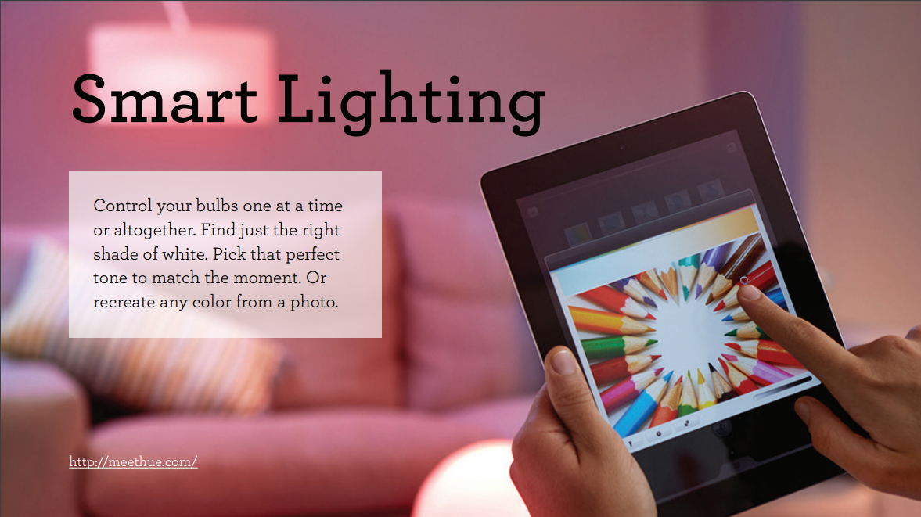

Slide 36
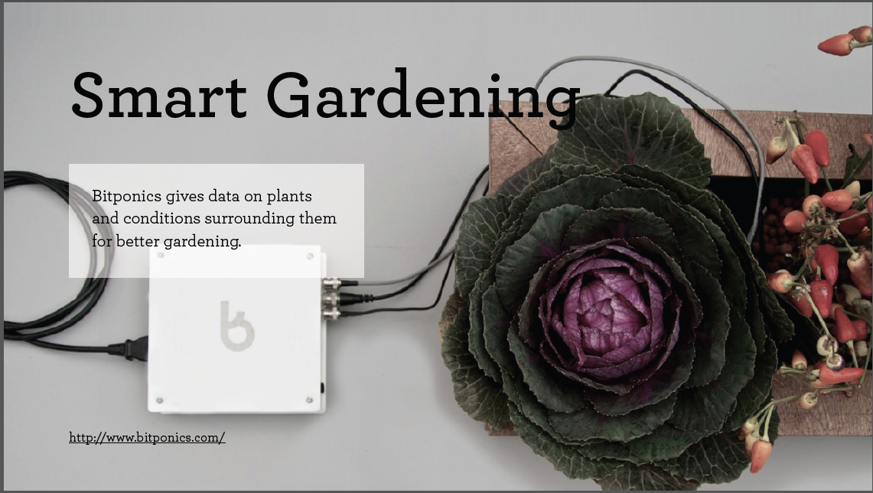

Slide 37
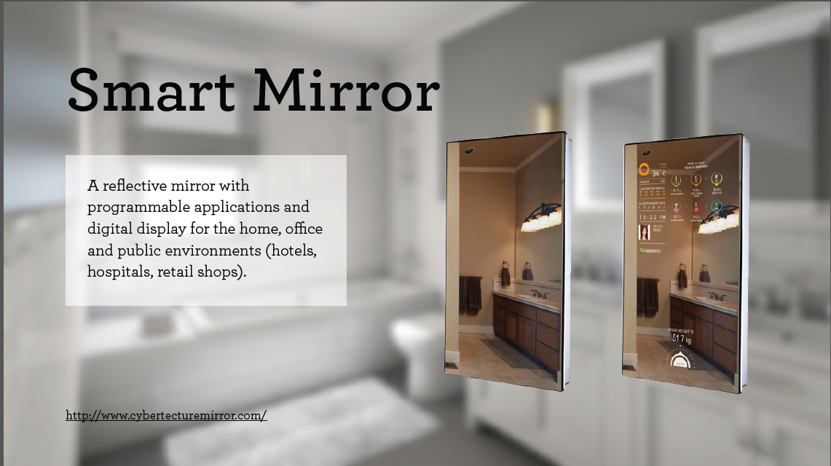

Slide 38


Slide 39
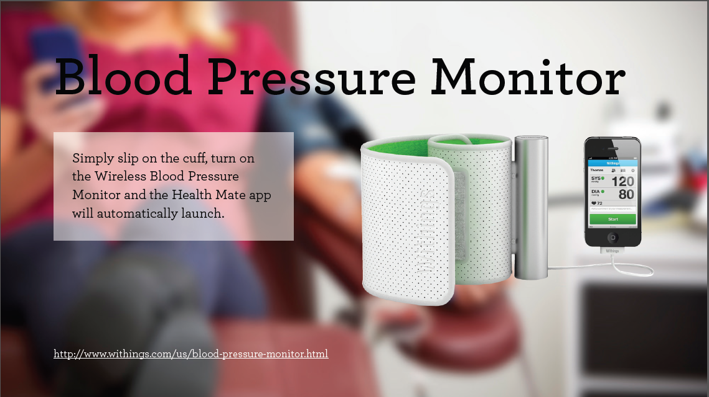

Slide 40
THANK YOU…

